Slide 1
CS 4530: Fundamentals of Software Engineering Module 3.2: Code Coverage & Mutation Testing
Adeel Bhutta
Khoury College of Computer Sciences
© 2026 Released under the CC BY-SA license

Slide 2
Learning Goals for this Lesson
At the end of this lesson, you should be able to
Explain what code coverage is, and how different measures differ, including statements, branches, functions, and lines
Explain the benefits of mutation testing

Slide 3
When have I written enough tests?
Notes:
Returning to the key question: when have we written enough tests.
Well, why do we write tests in the first place? That might help us know when we’re done.

Slide 4
Why do we test? Because Tests are the specification!
Test Driven Development
If we start with tests, passing the tests lets us know we’re done meeting the conditions of satisfaction
Acceptance Testing
Does the customer agree we’ve met the conditions of satisfaction?
Regression Testing
Did something change since some previous version?
Prevent bugs from (re-)entering during maintenance.
“Good” test suite detects bugs that (inevitably) get added as software is developed over time: tests are for the future
Notes:
Our focus in the last lecture was on testing as part of the test-driven development process: testing is so we know when we’re done building the thing we’re building. That’s still true, but there are some other important considerations worth mentioning.
Software engineering is about developing software for people in groups over time. The assumption behind test-driven specification is that the real specification is often not written out explicitly or precisely, so often the tests are the most effective documentation of that unwritten spec, and that documentation may be all that anyone remembers when it matters.
You may have specific domain knowledge that future developers who touch the code do not (or that you will forget)
This leads to the Beyonce rule: "if you liked it you should have put a test on it". This rule recognizes that often the tests *are* the specification.

Slide 5
When Have I Written Enough Tests?
When I’ve tested the valid inputs
When I’ve tested all the code
When the tests will catch bugs
Notes:
The first answer we give, when I’ve described all the valid inputs, motivated some more discussion of TypeScript.
The future focus of regression testing is what motivates the last two answers:
The second answer is based on code coverage, a very common metric of test adequacy in modern software engineering.
The third answer is pretty direct: we’ve written enough tests when the tests will catch bugs!

Slide 6
Code Coverage
The industry standard answer for “have I written enough tests”
Measures “how much of your code” is exercised by your tests
If none of your test even execute a piece of code, it’s not being tested!
Notes:
That talks about what our goals are for writing enough tests. In most software engineering applications, when we measure whether we’re writing good tests, we are talking about measuring code coverage.
Measuring code coverage is based on a really simple thought: if you’re not running code, you’re not testing it.

Slide 7
Code Coverage: Line or Statement Coverage
Line and Statement coverage are a coarse measurement.
Testing x = 0 exercises lines 2 and 3
Testing x = 10 exercises lines 2, 5, 6, and 7.
1| export function f(x: number) {
2| if (x === 0) {
3| return 3;
4| }
5| const y = x > 4 ? 2 : 3;
6| const z = x % 2 === 0 ? 1 : 2;
7| return x / (y - z);
8| }

Slide 8
Code Coverage: Branch Coverage
Branch coverage: widely used in industry.
Testing with x > 4 and x <= 4 necessary to handle both branches on line 5.
Testing with odd and even numbers necessary to handle both branches on line 6.
The values -2, 0, 1, and 10 get full branch coverage.
1| export function f(x: number) {
2| if (x === 0) {
3| return 3;
4| }
5| const y = x > 4 ? 2 : 3;
6| const z = x % 2 === 0 ? 1 : 2;
7| return x / (y - z);
8| }

Slide 9
Code Coverage: Path Coverage
The values -2, 0, 1, and 10 get full branch coverage…
…but 5 causes line 7 to divide by zero!
In JavaScript/TypeScript, this doesn’t cause an exception, there’s a number called “Infinity” (which is different from “NaN,” for “not a number”)
Path coverage covers all combinations of branches; it is infeasible in practice.
1| export function f(x: number) {
2| if (x === 0) {
3| return 3;
4| }
5| const y = x > 4 ? 2 : 3;
6| const z = x % 2 === 0 ? 1 : 2;
7| return x / (y - z);
8| }

Slide 10
Code Coverage: Example 1
What tests will get line/branch/path coverage here?
/** Returns an array that repeats "hello"
* @param numHellos - number of “hello”s to return, must be an integer >= 0
*/
function helloNTimes(numHellos: number): string[] { const arr: string[] = [];
for (let i = numHellos; i !== 0; i--) { arr.push("hello"); } return arr;
}
Notes:
(Answer: just the input 1 will get line coverage and branch coverage. That’s not great! But path coverage would take an infinite number of tests. This metric isn’t perfect!)

Slide 11
Code Coverage: Example 2
What tests will get line/branch/path coverage here?
const zHelloInput = z.int().gte(0);
/** Returns an array that repeats "hello"
* @param numHellos - number of times to say “hello”
* @throws if the input is not an integer >= 0
*/
function helloNTimes(numHellos: unknown): string[] { const parseResult = zHelloInput.safeParse(numHellos);
if (!parseResult.success) throw new Error("Invalid input");
const arr: string[] = [];
for (let i = parseResult.data; i !== 0; i--) { arr.push("hello"); } return arr;
}
Notes:
In the version of helloNTimes that gets untrusted inputs, there’s an extra branch that needs to be tested: we need to give at least a valid and invalid input.

Slide 12
Code Coverage and “edge” cases can be related
Some of our intuition about “edge cases” can be understood in terms of trying to imagine inputs that will provide code coverage for an unknown function.
BUT: code coverage won’t tell you to check 0 specifically if there’s a branch that checks x >= 0
Thinking about the “edge case” of a branch is a good move
What inputs should we start with if:
We’re taking numbers that are supposed to represent a 5-digit zip code?
We’re taking strings that are supposed to represent a 5-digit zip code?
We’re taking an array of strings that represent people’s names?
Notes:
Possible answers:
numbers too large or small to be zip codes, zip codes that start with one or more zeros
Strings too short or two long to be a 5-digit zip code, 5-digit numbers that are and are not valid zip codes, 5-character strings that aren’t all digits
Arrays that are empty, that contain duplicate names, that contain all unique names, that are sorted or not

Slide 13

Code Coverage in Vitest
Tools like vitest makes it easy to check code coverage

Slide 14
Code Coverage: Review
Total code coverage — by any metric — does not mean no bugs
Running code doesn’t mean checking that it’s doing the right thing! (important to Assemble/Act/Assess)
“Coverage is no substitute for thought” — Rob Pike
Coverage checking can be invaluable at identifying when you think you’re testing something but you’re not, which is a real problem in practice.
Test-Driven Development also valuable for this problem: it’s important that tests switch from failing to succeeding when you expect them to
Notes:
(Rob: I’ve been saved more than once by trying to intentionally break my code and noticing that the test I expected to fail didn’t fail — this meant the test wasn’t checking what I expected it to!)

Slide 15
When Have I Written Enough Tests?
When I’ve tested the valid inputs
When I’ve tested all the code
When the tests will catch bugs
Notes:
The first answer we give, when I’ve described all the valid inputs, motivated some more discussion of TypeScript.
The future focus of regression testing is what motivates the last two answers:
The second answer is based on code coverage, a very common metric of test adequacy in modern software engineering.
The third answer is pretty direct: we’ve written enough tests when the tests will catch bugs!

Slide 16
Adversarial Testing
It can be helpful to think of testing as a game in which you play against an adversary.
Your adversary plays by producing multiple versions of code that you agree is buggy, and multiple versions of code you agree is correct.
Your win if your tests catch all the buggy code, and pass all the correct code.
Notes:
When we need a graph to measure “have we written enough tests,” code coverage is absolutely what everyone uses. But we’ve just seen a couple of ways that this can fail to tell us that we’ve written enough tests — or at least, fail to tell us when our tests are any good.
A much more robust way to think about the question of have I written enough tests is the idea of adversarial testing. Could someone else write a buggy version of your code that your tests would fail to catch?

Slide 17

Adversarial Testing
Original code (correct)
// find the first item in the list that is
// greater than or equal to the target.
export default function search(list:number[], target:number) {
return list.find((item) => item >= target);
}
Mutated code (buggy)
// find the first item in the list that is
// greater than or equal to the target.
export default function search(list:number[], target:number) {
return list.find((item) => item > target);
}
Notes:
Here’s an example of a function that has an error that you might make if you were in a hurry, or tired, or it was late at night.
Snidely Whiplash (over there on the right) asks "can your tests tell that something went wrong"?
Q: can think of a test that would catch the error (search([1,2,3],2) — will return 3 instead of 2)
Q: can you think of a test that would fail to catch the error (search([1,2,5], 3) — will correctly return 5)
Would the failing test ace our code coverage tests (yes!)

Slide 18
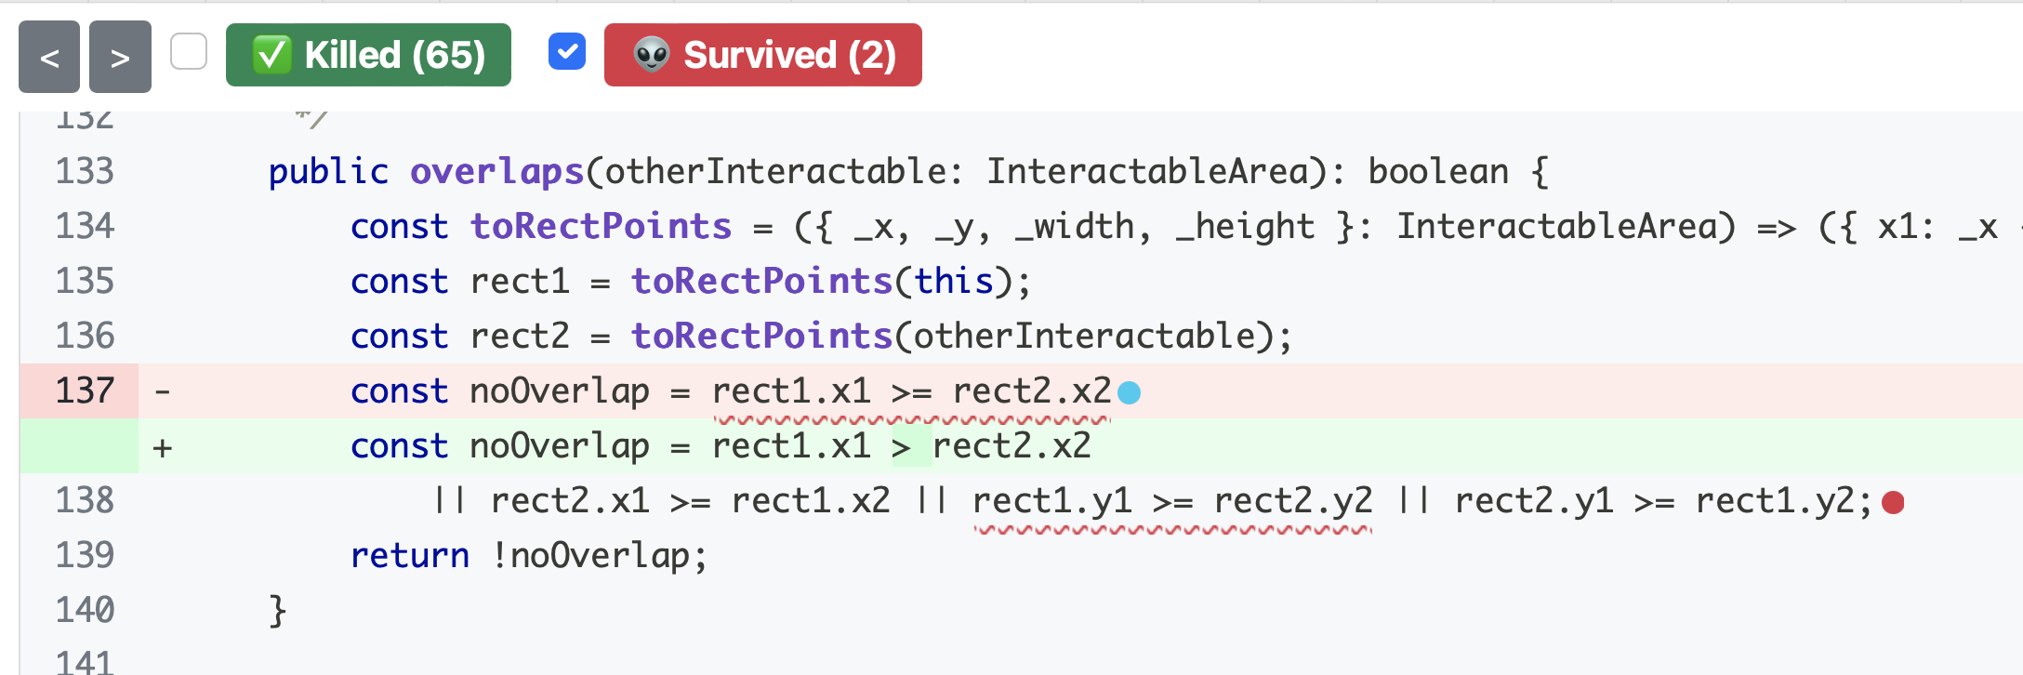
Adversarial Testing
Stryker is a mutation tester for JavaScript — an automated adversary!
Notes:
The idea of "mutation testing" is that most defects are the result of simple errors. (Is this a realistic assumption? Spoiler alert: it's realistic enough!)
In mutation testing, the adversary generates buggy code by making simple changes. Generating buggy code in this way is clearly automatable.

Slide 19
Remedy: you need to devise tests that distinguish the original code from the mutants
Devise a test that your original code will pass, but the mutant will fail.
Notes:
<read slide>

Slide 20
A tiny example
Imagine that this is the code to be tested
// find the first item in the list that is
// greater than or equal to the target.
export default function search(list:number[], target:number) {
return list.find((item) => item >= target);
}
and we have written some tests.
Notes:
Let's look at a tiny example. <Read Slide> Next, let's look at the Stryker report for this example.

Slide 21
Stryker report for this test
[Survived] EqualityOperator
src/for-midterm/adrian.ts:4:32
- return list.find((item) => item >= target);
+ return list.find((item) => item > target);
Tests ran:
search should return the first item in the list that is greater than or equal to the target
[Survived] ConditionalExpression
src/for-midterm/adrian.ts:4:32
- return list.find((item) => item >= target);
+ return list.find((item) => true);
Tests ran:
search should return the first item in the list that is greater than or equal to the target
The location of the mutation
The tests that were run on this piece of code
Notes:
Here is the actual Stryker report for my initial set of tests. (There was actually only one test in my suite, but that doesn't make a difference)
Let's look at each of these mutants in turn. Point out: the location of the mutation; the titles of the test(s) that covered this location (in this case, there was only one test, so they are both the same).

Slide 22
Let's look at the second one:
[Survived] ConditionalExpression
src/for-midterm/adrian.ts:4:32
- return list.find((item) => item >= target);
+ return list.find((item) => true);
How does this mutant behave differently from the original?
Answer: This mutant always returns the first element of the list
Remedy: Add a test that searches for something that is NOT the first element in the input?
Notes:
When do these code fragments behave differently? How could we give the program an input that makes the mutant fail?.
Discuss.
Ans: the mutant always returns the first element of the list. You could distinguish them by giving an input that should return some other element of the list

Slide 23
Here's one test that will cause the mutant to be killed.
test("should return the second element of the list", () => {
expect(search([5, 7, 9], 6)).toBe(7);
});

Slide 24
What about the other mutant?
[Survived] EqualityOperator
src/for-midterm/adrian.ts:4:32
- return list.find((item) => item >= target);
+ return list.find((item) => item > target);
How does this mutant behave differently from the original?
Answer: This mutant returns the first element of the list that is larger than the original
Remedy: Add a test where the input list included an “equal” item before a larger item
Notes:
Under what conditions will these two program fragments behave differently? How could we write a test to create those conditions?
DISCUSS.
ANS: if the target is equal to one of the list items, the second one will keep going and return a different one.

Slide 25
Here's one test that will catch that mutant
test("try target that is equal to some item in the list", () => {
expect(search([5, 7, 9], 7)).toBe(7);
});
Notes:
We've made the mutant fail, but our correct program succeeds.

Slide 26
Use Mutation Analysis While Writing Tests
When you feel “done” writing tests, run a mutation analysis
Inspect undetected mutants, and try to write tests that will make those mutants fail.
Detailed mutation report for “overlaps” method - two mutants were not detected!
Notes:
Mutation analysis helps us improve our tests as we write them, because it shows us changes to our code (potential bugs!) that our tests do not detect. Remember, that to “detect” a mutant means that at least one test in your test suite fails when run on the mutated code.
Stryker actually reports both in plain text form, as we showed before, and as a handy html page. Here is a piece of the html report, running on an 'overlaps' method from Covey.town (our project from last year). In this screenshot, we can see an undetected mutant, on line 137. The red highlighting (with the minus sign) shows how the line was before the mutation, and the green highlighting (with the plus sign) shows the line after the mutation. In this case, the mutation was to replace a >= with a > sign.
There is also an undetected mutation on line 138, but it is not expanded (the red dot). When working through the report, you'll see them a single mutant at a time (because that’s what was run – one mutant at a time).
Was this a bug? I don't know, because I don't have enough context to decide ☺. But when you are running Stryker, you *will* know the context.

Slide 27
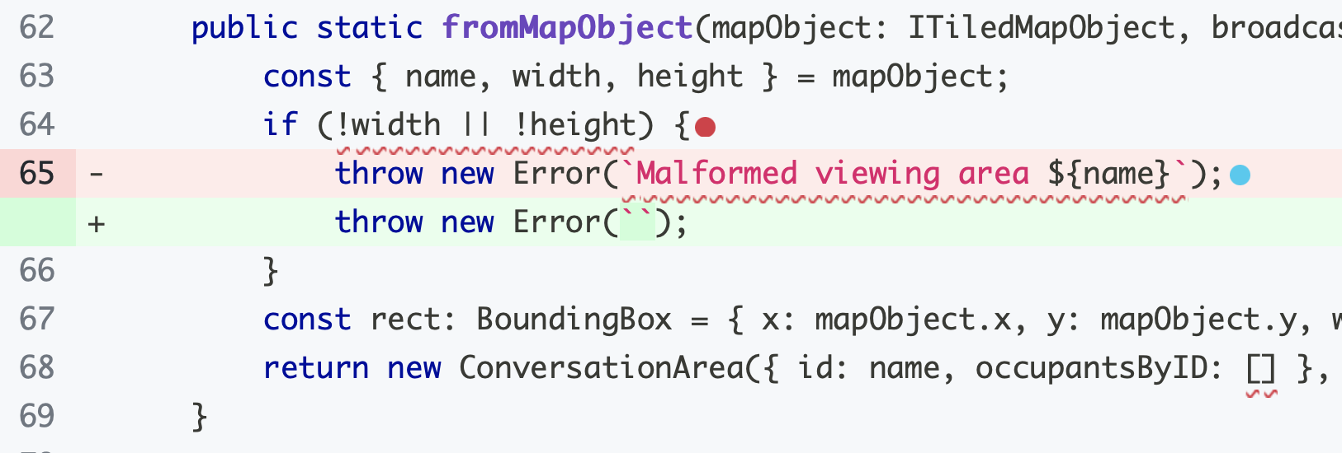
Adversarial Testing and Overspecification
Stryker is a mutation tester for JavaScript — an automated adversary!
Sometimes it loses the game because mutants aren’t bugs.
Notes:
Adversarial testing is a game, and sometimes your adversary loses the game because the “mutant” isn’t a bug.
If the spec is just “throw an error if the width or height is nonzero” then this change is fine.
This is related to a real problem with tests: they can be overspecified, and can test properties of your program you don’t actually care about. In the Tic-Tac-Toe example in your homework, the tests have to be carefully written, because it doesn’t matter whether you describe a winning line as ([[0,0], [1,1], [2,2]]) or ([[1,1], [0,0], [2,2]]).
Overly-specific tests aren’t generally a huge problem, but they can lead to flaky tests — imagine a tic-tac-toe program has randomness, and some of the time it reports solutions in a different order, so your fail… some of the time. (We’ll return to this idea in a later lecture.)

Slide 28

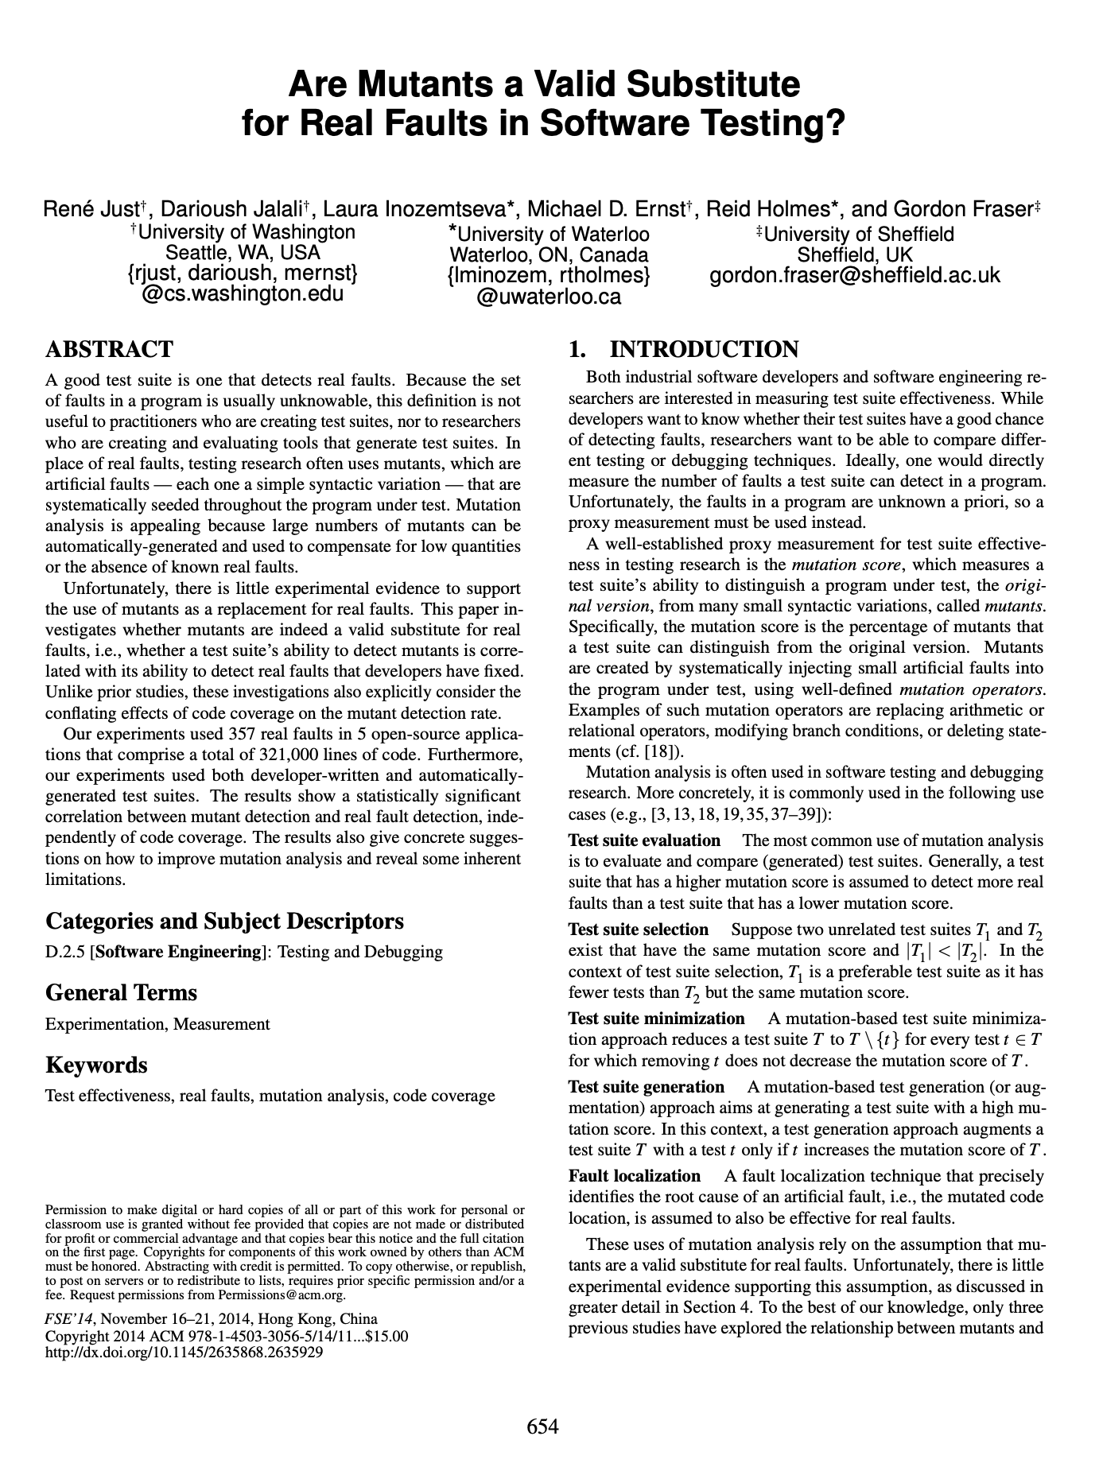
Are mutants a Valid Substitute for Real Faults? Probably yes.
Do mutants really represent real bugs?
Researchers have studied the question of whether a test suite that finds more mutants also finds more real faults
Conclusion: For the 357 real faults studied, yes
This work has been replicated in many other contexts, including with real faults from student code
Notes:
You might look at these mutants, which are caused by such simple operations, and wonder: but do these one-line mutations really represent the kinds of bugs that occur in real software? Because ultimately, that is what we are looking to evaluate, right? Do our tests find real bugs?
This study (and others that have replicated it) is important because it shows that this process of enhancing a test suite to detect more mutants might be worth the effort, because there is empirical evidence that: given two test suites, where one detects more mutants than the other (on the same SUT — System Under Test), the one that detects more mutants also finds more real bugs.

Slide 29
Review
It’s the end of the lesson, so you should be able to
Explain what code coverage is, and how different measures differ, including statements, branches, functions, and lines
Explain the benefits of mutation testing
When have you written enough tests?
When you’ve tested all valid inputs?
When your tests get full code coverage?
When your tests can catch any buggy mutant code?
The answer depends!
Notes:
When have you written enough tests?
If you’re trying to make a graph or report progress to your boss — if you have tests that Assemble/Act/Assess and have 100% branch coverage, you’ve written enough tests.
If you really care about tests that do a good job making sure your code is correct, now and in the future: if your tests will always win the “game” of adversarial testing and find a bug in any buggy implementation.

